Slide 1

Android App Development
Name kHUSHI KumarI
Reg no 190101120077

Slide 2
Topic
Installation of Android Studio, Android Virtual Device (AVD). Show the steps with help of snapshots.

Slide 3
System Requirements
Microsoft Windows 7/8/10 (32-bit or 64-bit)
4 GB RAM minimum, 8 GB RAM recommended (plus 1 GB for the Android Emulator)
2 GB of available disk space minimum, 4 GB recommended (500 MB for IDE plus 1.5 GB for Android SDK and emulator system image)
1280 x 800 minimum screen resolution

Slide 4
Installation of Android Studio

Slide 5
Windows
To install Android Studio on Windows, proceed as follows:
If you downloaded an .exe file (recommended), double-click to launch it. If you downloaded a .zip file, unpack the ZIP, copy the android-studio folder into your Program Files folder, and then open the android-studio > bin folder and launch studio64.exe (for 64-bit machines) or studio.exe (for 32-bit machines).

Slide 6
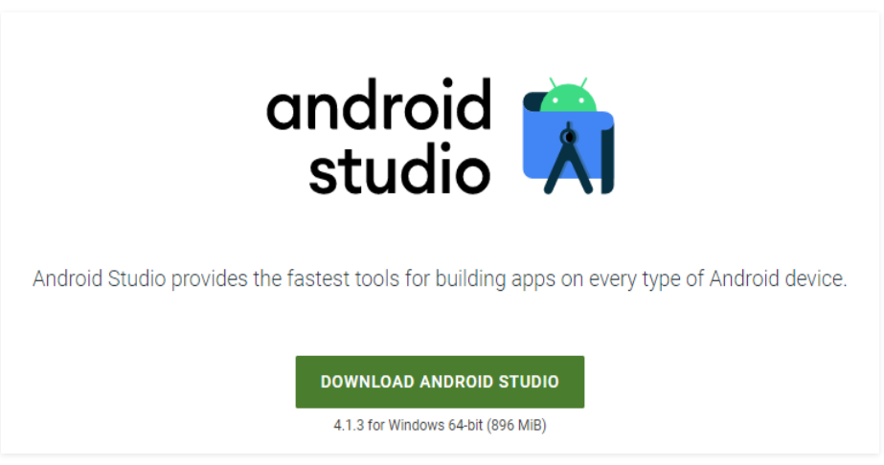
Step 1: Head over to this link to get the Android Studio executable or zip file. Step 2: Click on the Download Android Studio Button.

Slide 7
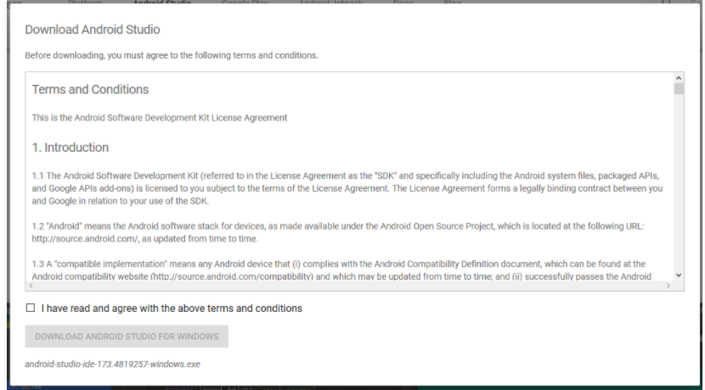

Slide 8
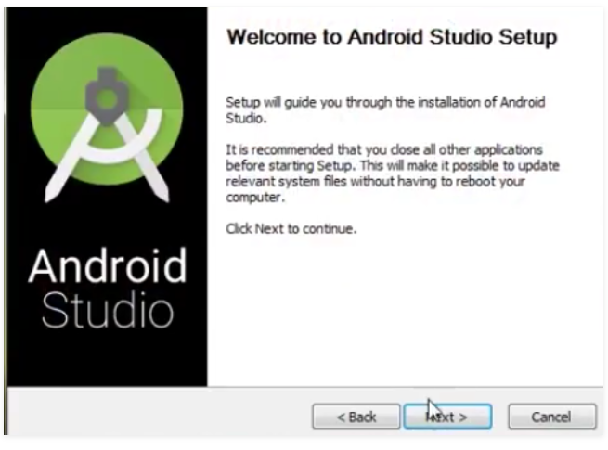
Step 3: After the downloading has finished, open the file from downloads and run it. It will prompt the following dialog box.

Slide 9
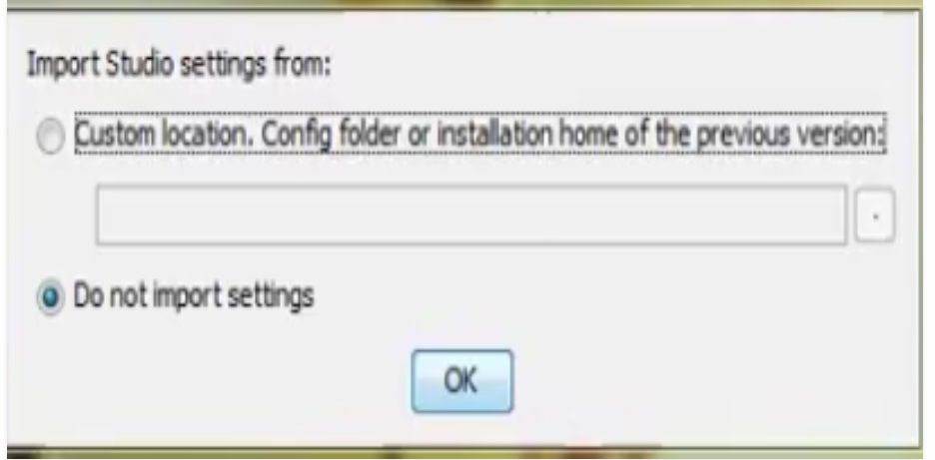
Step 4: It will start the installation, and once it is completed, it will be like the image shown below. Step 5: Once “Finish” is clicked, it will ask whether the previous settings need to be imported [if the android studio had been installed earlier], or not. It is better to choose the ‘Don’t import Settings option’.

Slide 10

Click the OK button. Step 6: This will start the Android Studio.

Slide 11
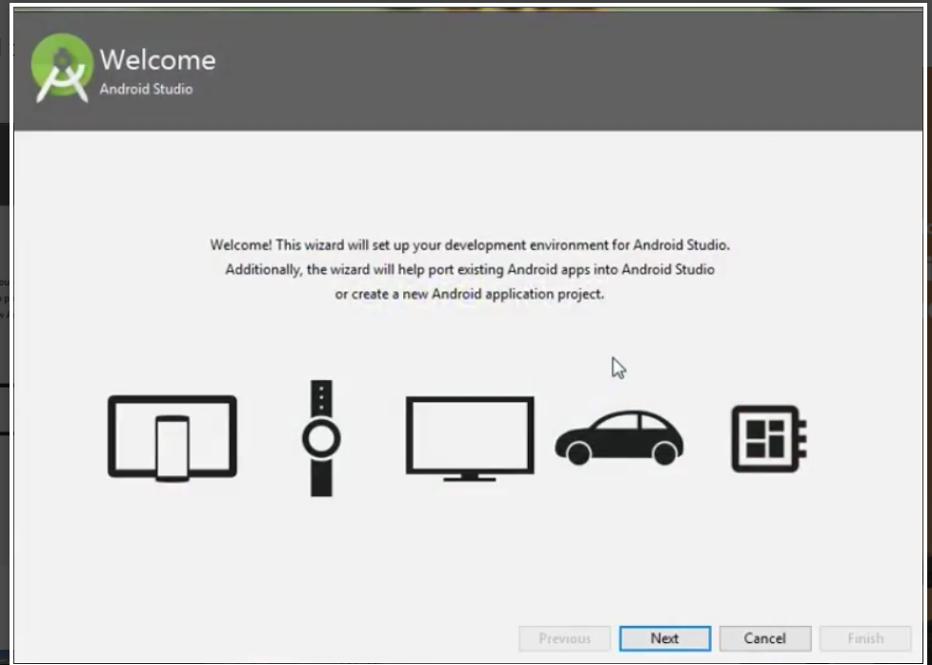
Step 7: After it has found the SDK components, it will redirect to the Welcome dialog box.

Slide 12
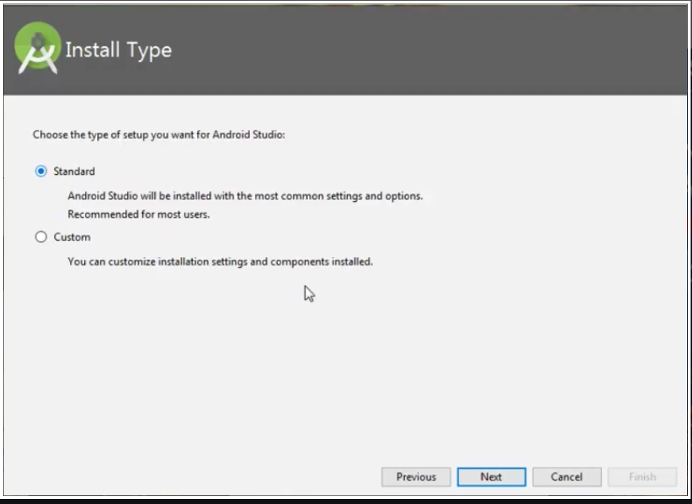

Slide 13
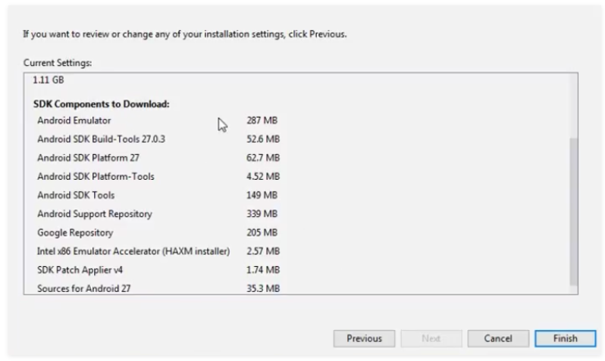
Step 8: Now it is time to download the SDK components

Slide 14
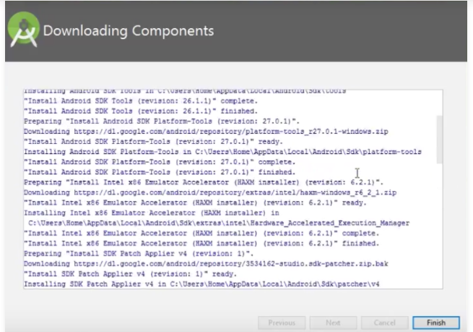

Slide 15
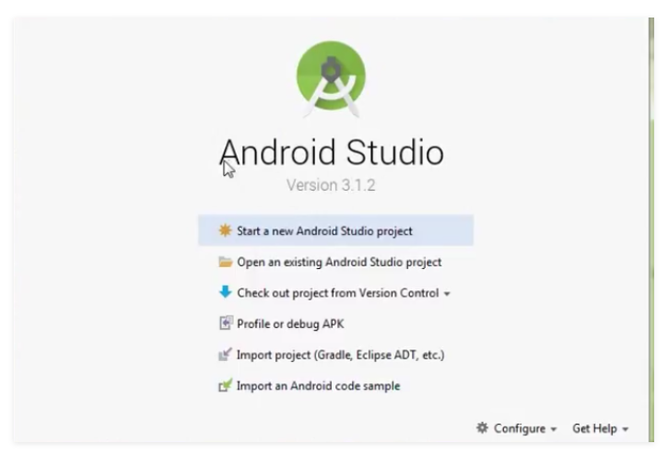
Step 9: Click on Start a new Android Studio project to build a new app.

Slide 16
2. Installation of Android Virtual Device
(AVD)

Slide 17
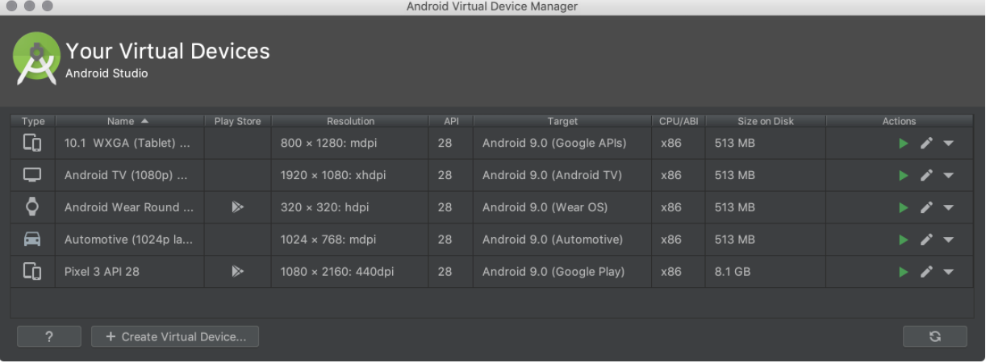
1. Open the AVD Manager by clicking Tools > AVD Manager.

Slide 18
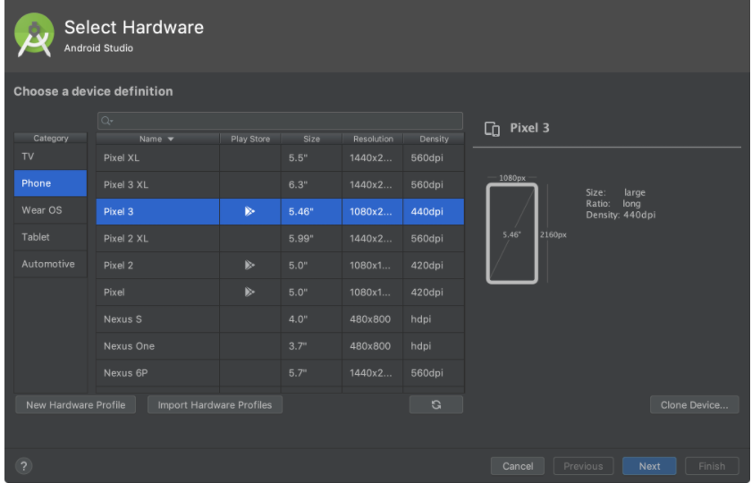
2. Click Create Virtual Device, at the bottom of the AVD Manager dialog. The Select Hardware page appears.

Slide 19
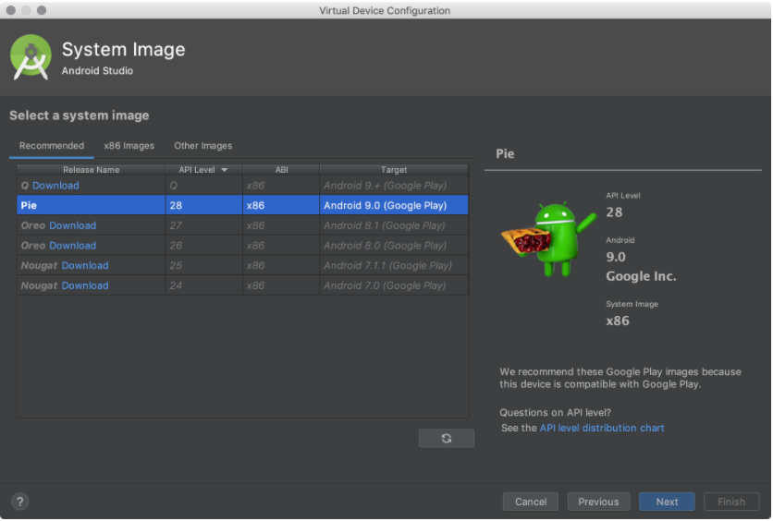
3.Select a hardware profile, and then click Next. If you don't see the hardware profile you want, you can create or import a hardware profile. The System Image page appears.

Slide 20
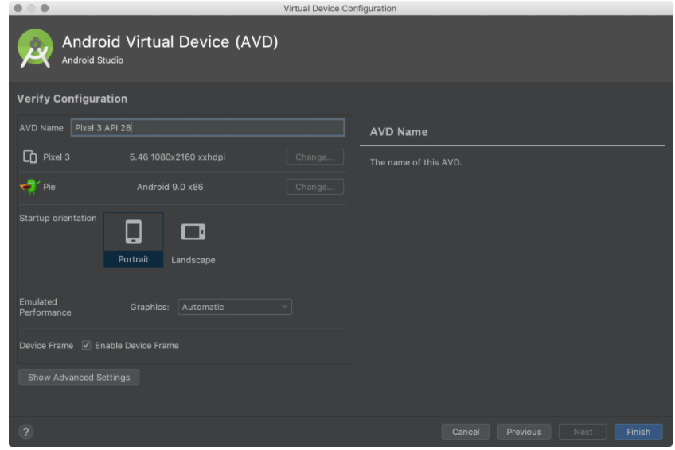
4.Select the system image for a particular API level, and then click Next.

Slide 21
5.Change AVD properties as needed, and then click Finish. Click Show Advanced Settings to show more settings, such as the skin. The new AVD appears in the Your Virtual Devices page or the Select Deployment Target dialog.

Slide 22
THANK YOU

